Slide 1
Housing and commuter rail infrastructure
An assessment of transit-oriented housing development in the Boston metro area suburbs
Tom Hopper – GIS for Urban/Regional Policy – Summer 2018

Slide 2
Housing and transit in metro Boston
Land use (zoning) decisions are made independently by 351 cities and towns
The commuter rail is a massive state public infrastructure investment
There are no requirements for towns to develop densely near commuter rail stations in order to maximize ridership and create more transit-oriented living options
Left to their own devices, many towns have not developed dense housing options around their commuter rail stations. This starves the region of much-needed housing while limiting the utility of the regional transit system.

Slide 3
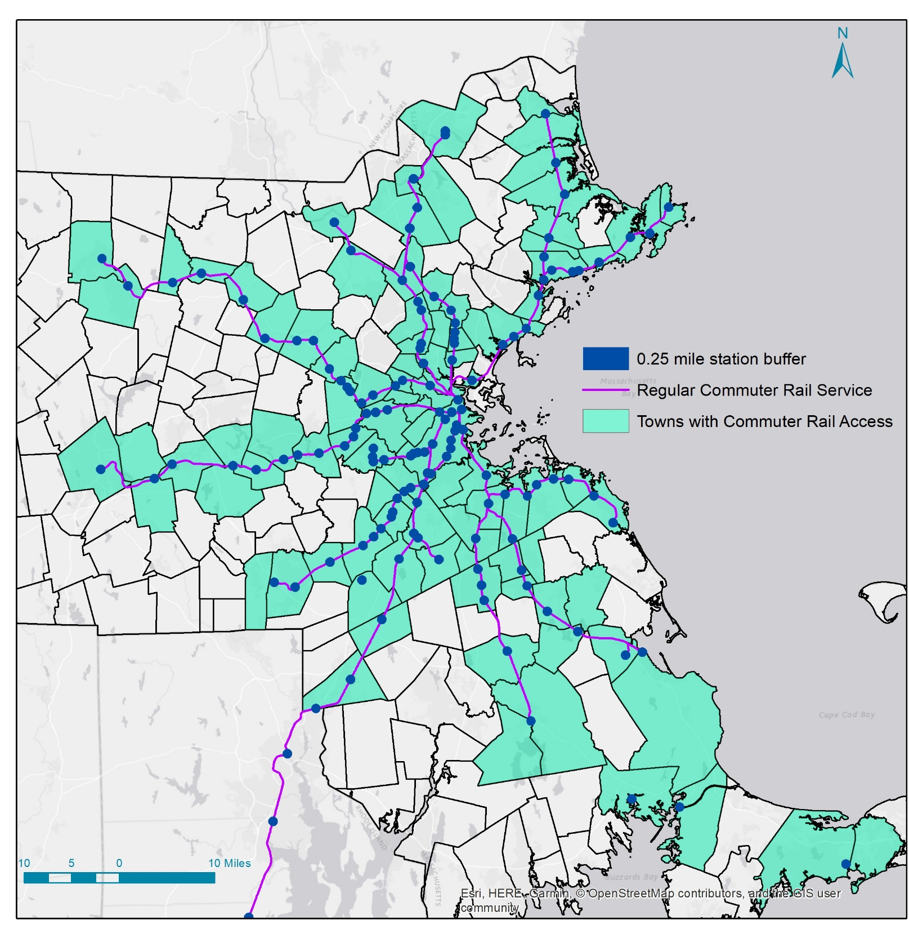
Geography
There are 136 commuter rail stations providing regular service
100 communities have commuter rail access
(defined as having parcels within ¼ mile of a station)

Slide 4
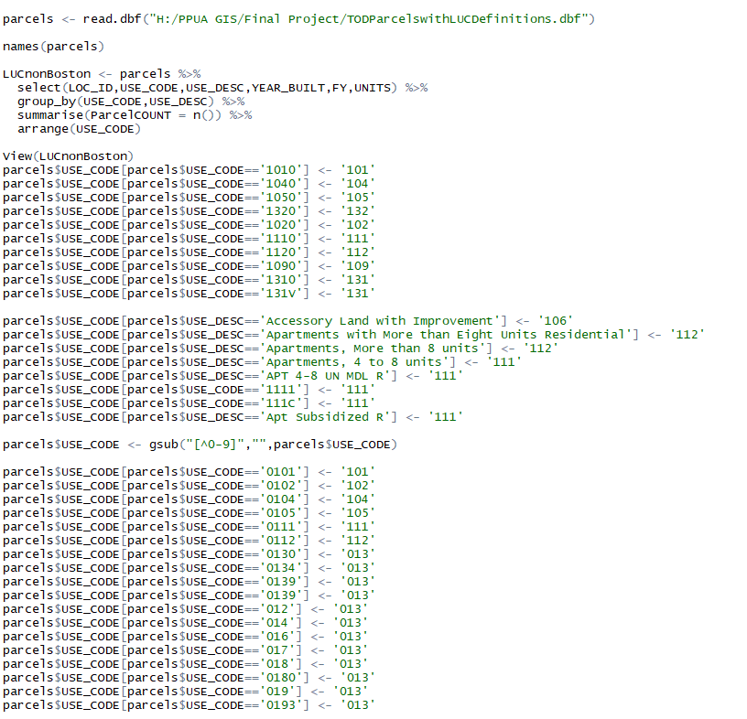
Real estate parcel data
Reported by each town’s tax assessor’s department, except Boston
Compiled and standardized by MassGIS
Key data points
Use code and type (single family house, multifamily apartments, etc.)
Year built
Number of units
Data issues
Use codes not 100% standardized
Number of units and year built missing for some records
File size is huge, making complex queries slow. Subdividing data necessary for some tasks.

Slide 5
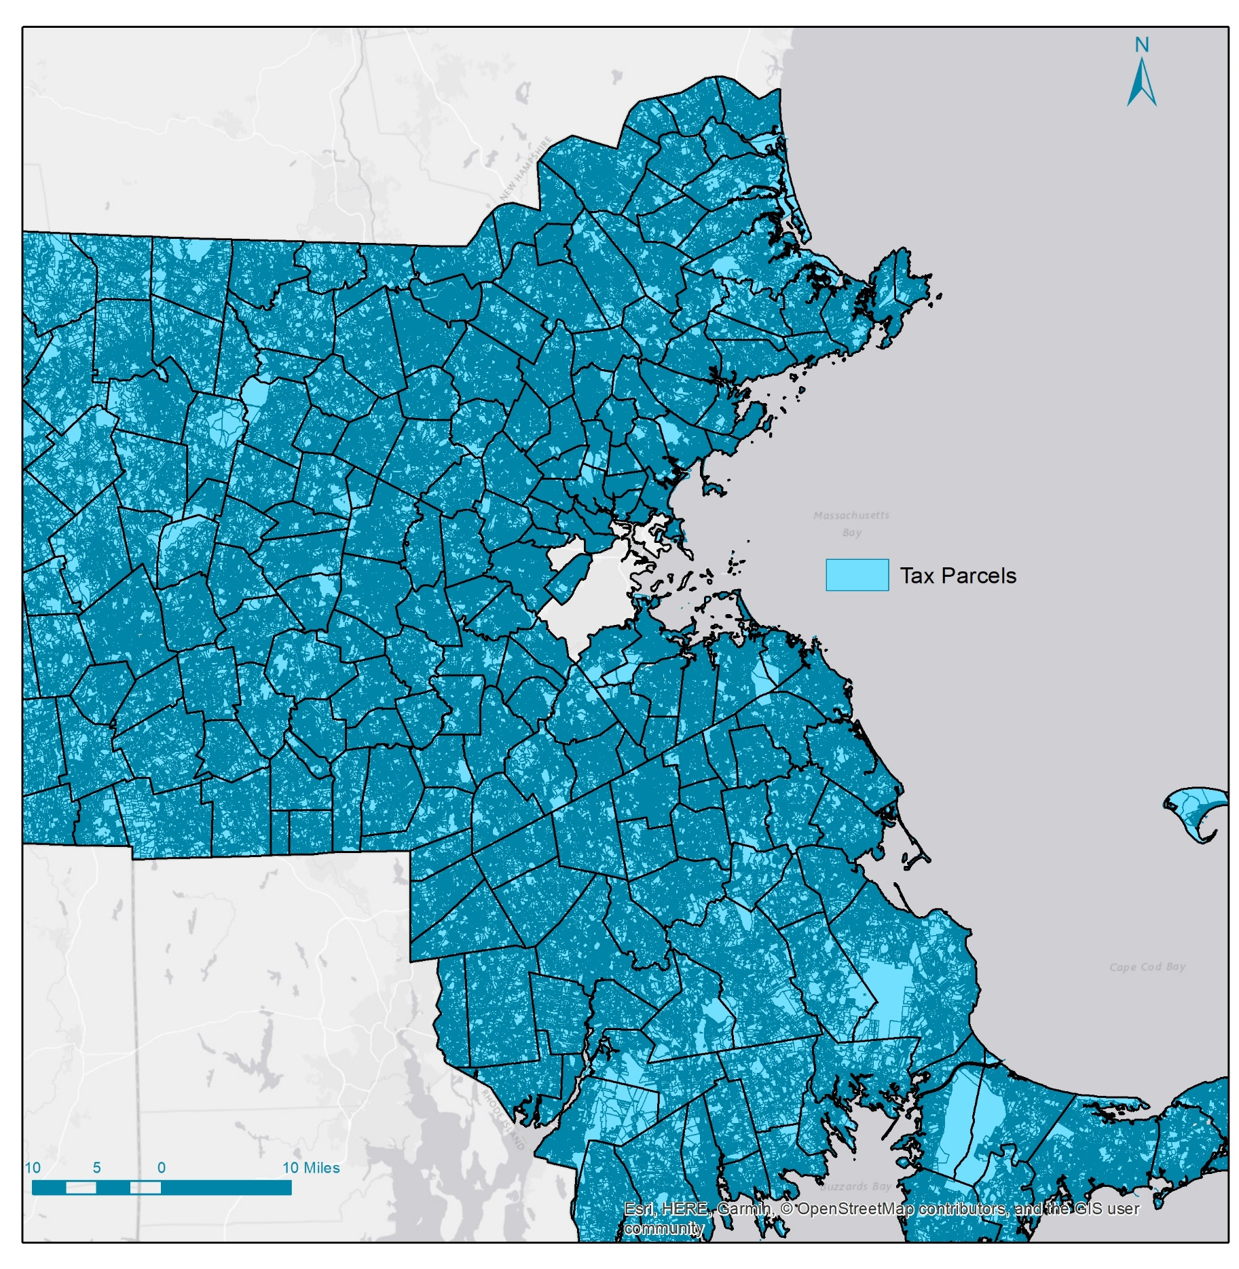

Slide 6
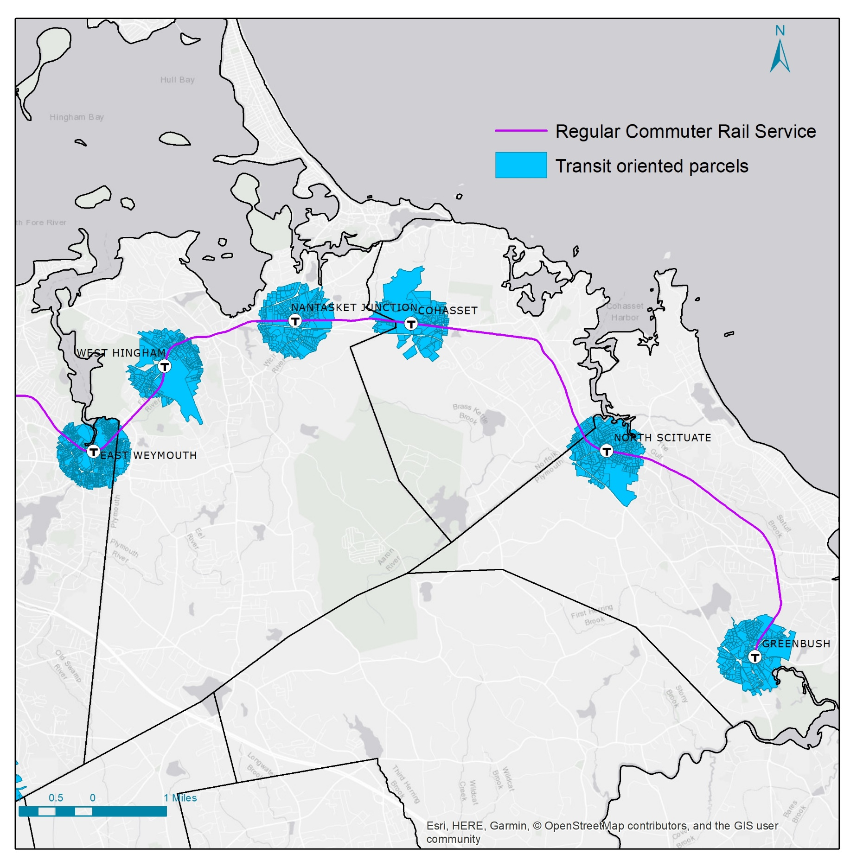

Slide 7
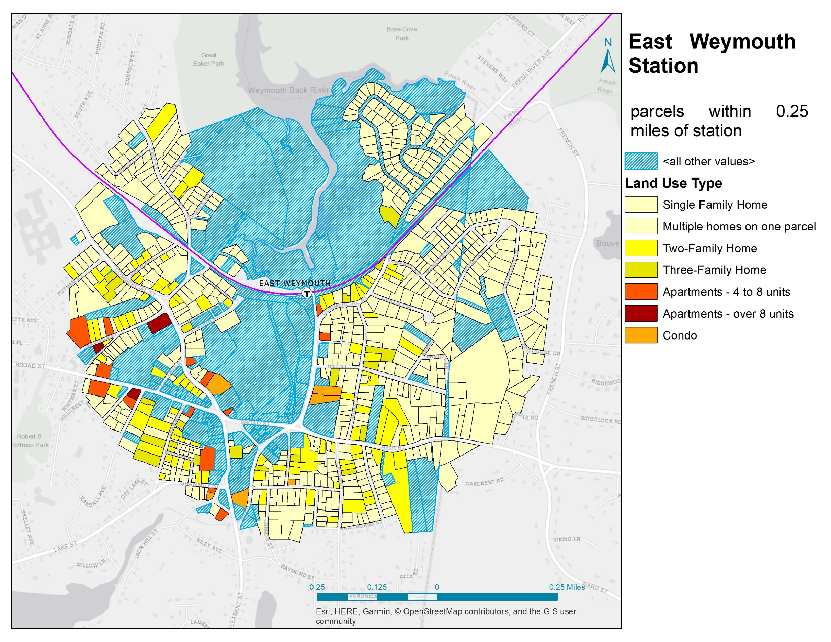
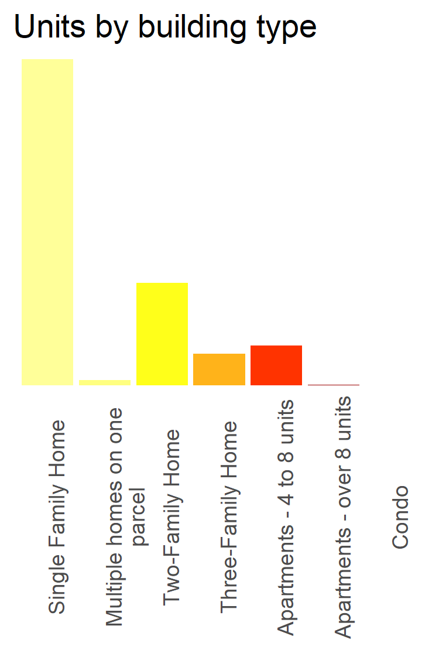
616
956
total
units
194
10
75
60
1
0

Slide 8
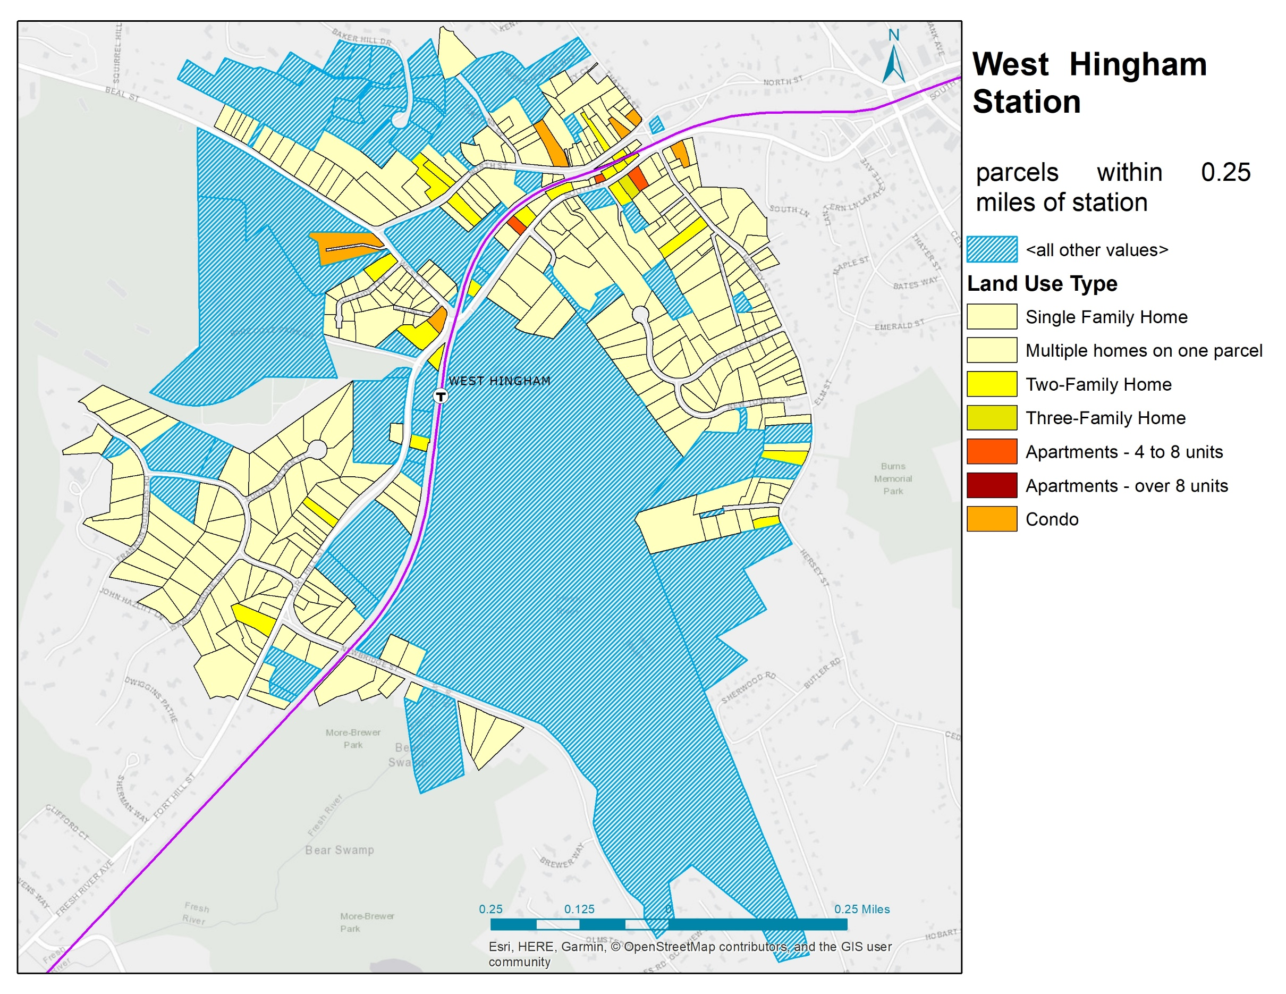
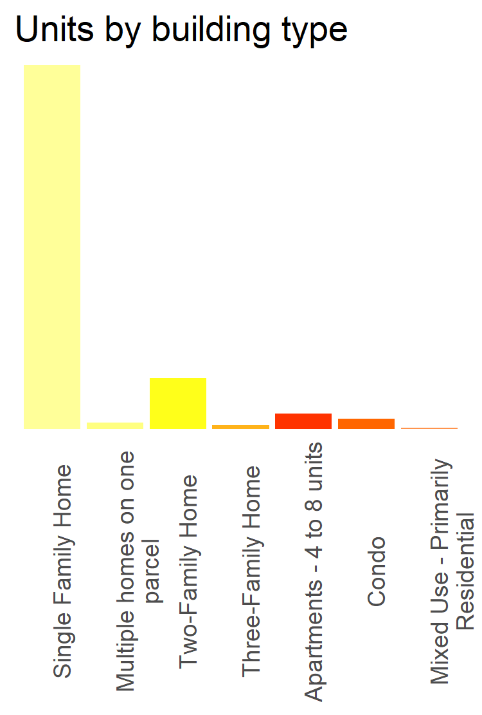
285
354
total
units
40
12
5
3
8
1

Slide 9
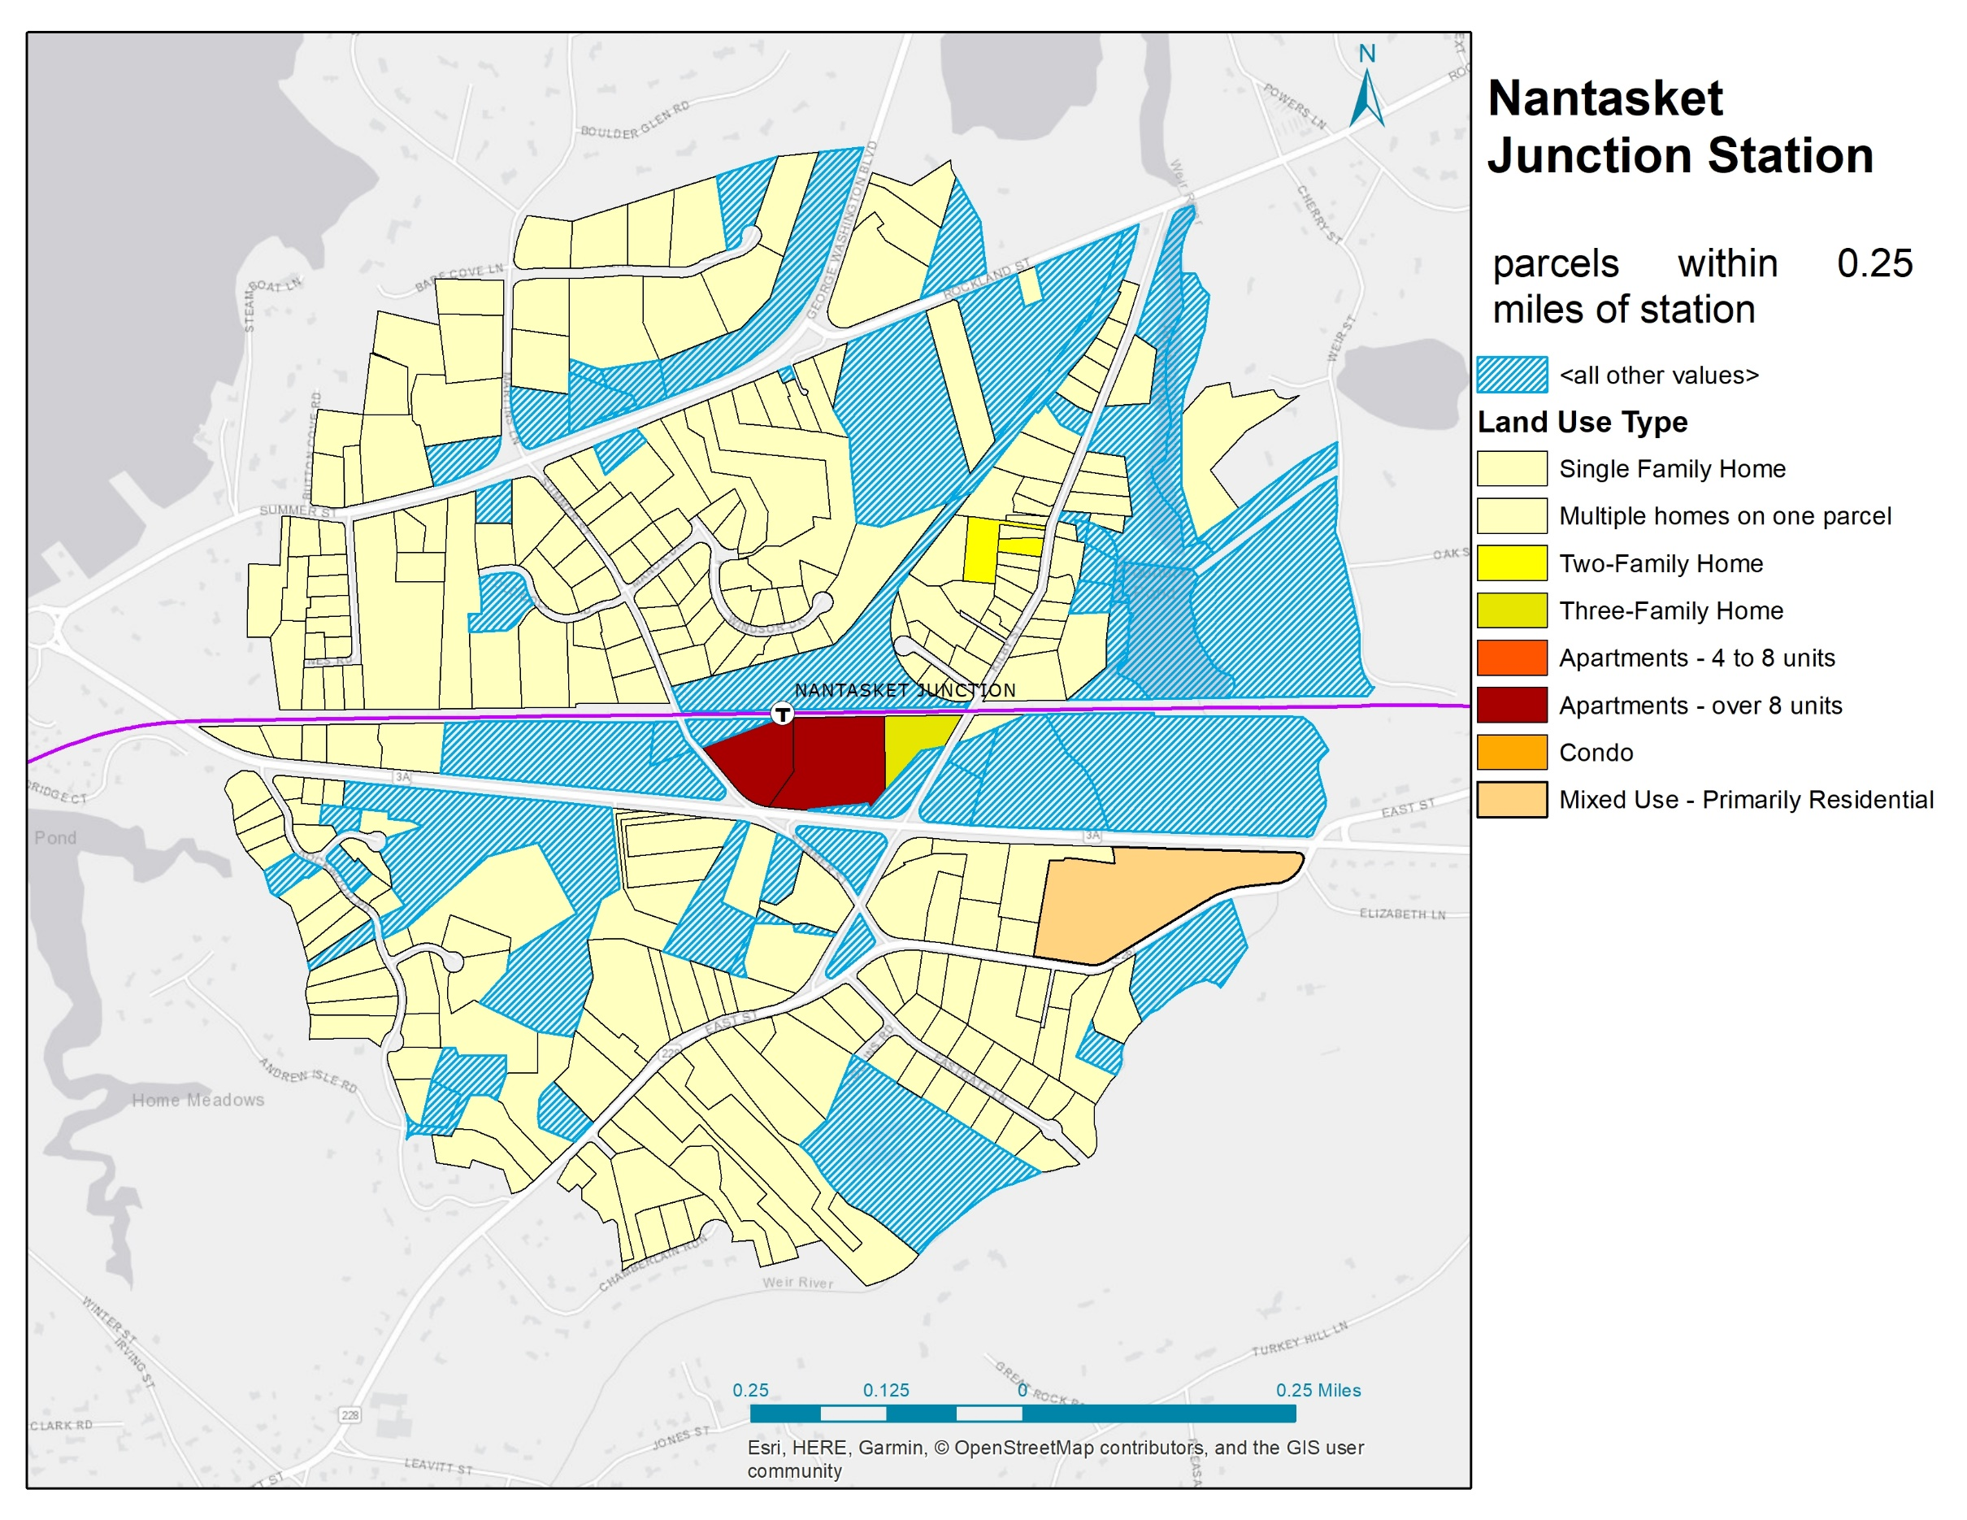
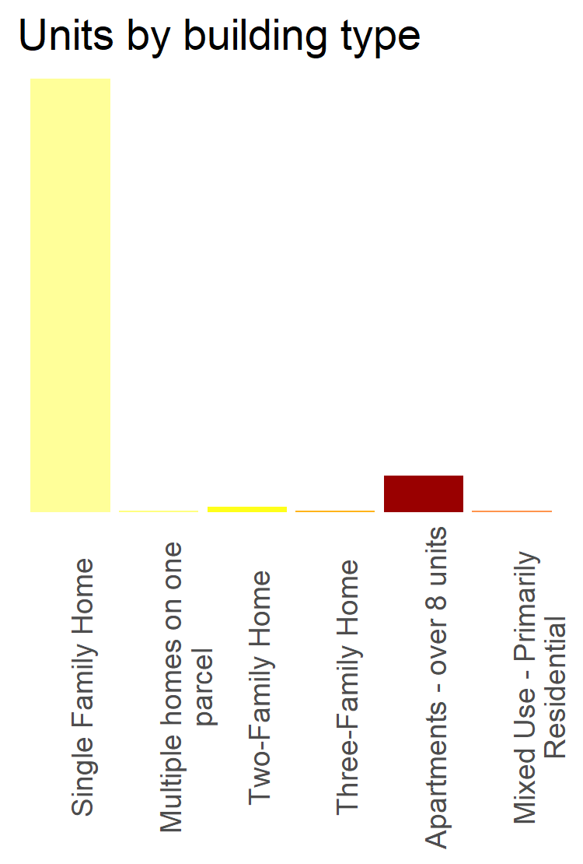
236
262
total
units
3
1
20
1
1

Slide 10
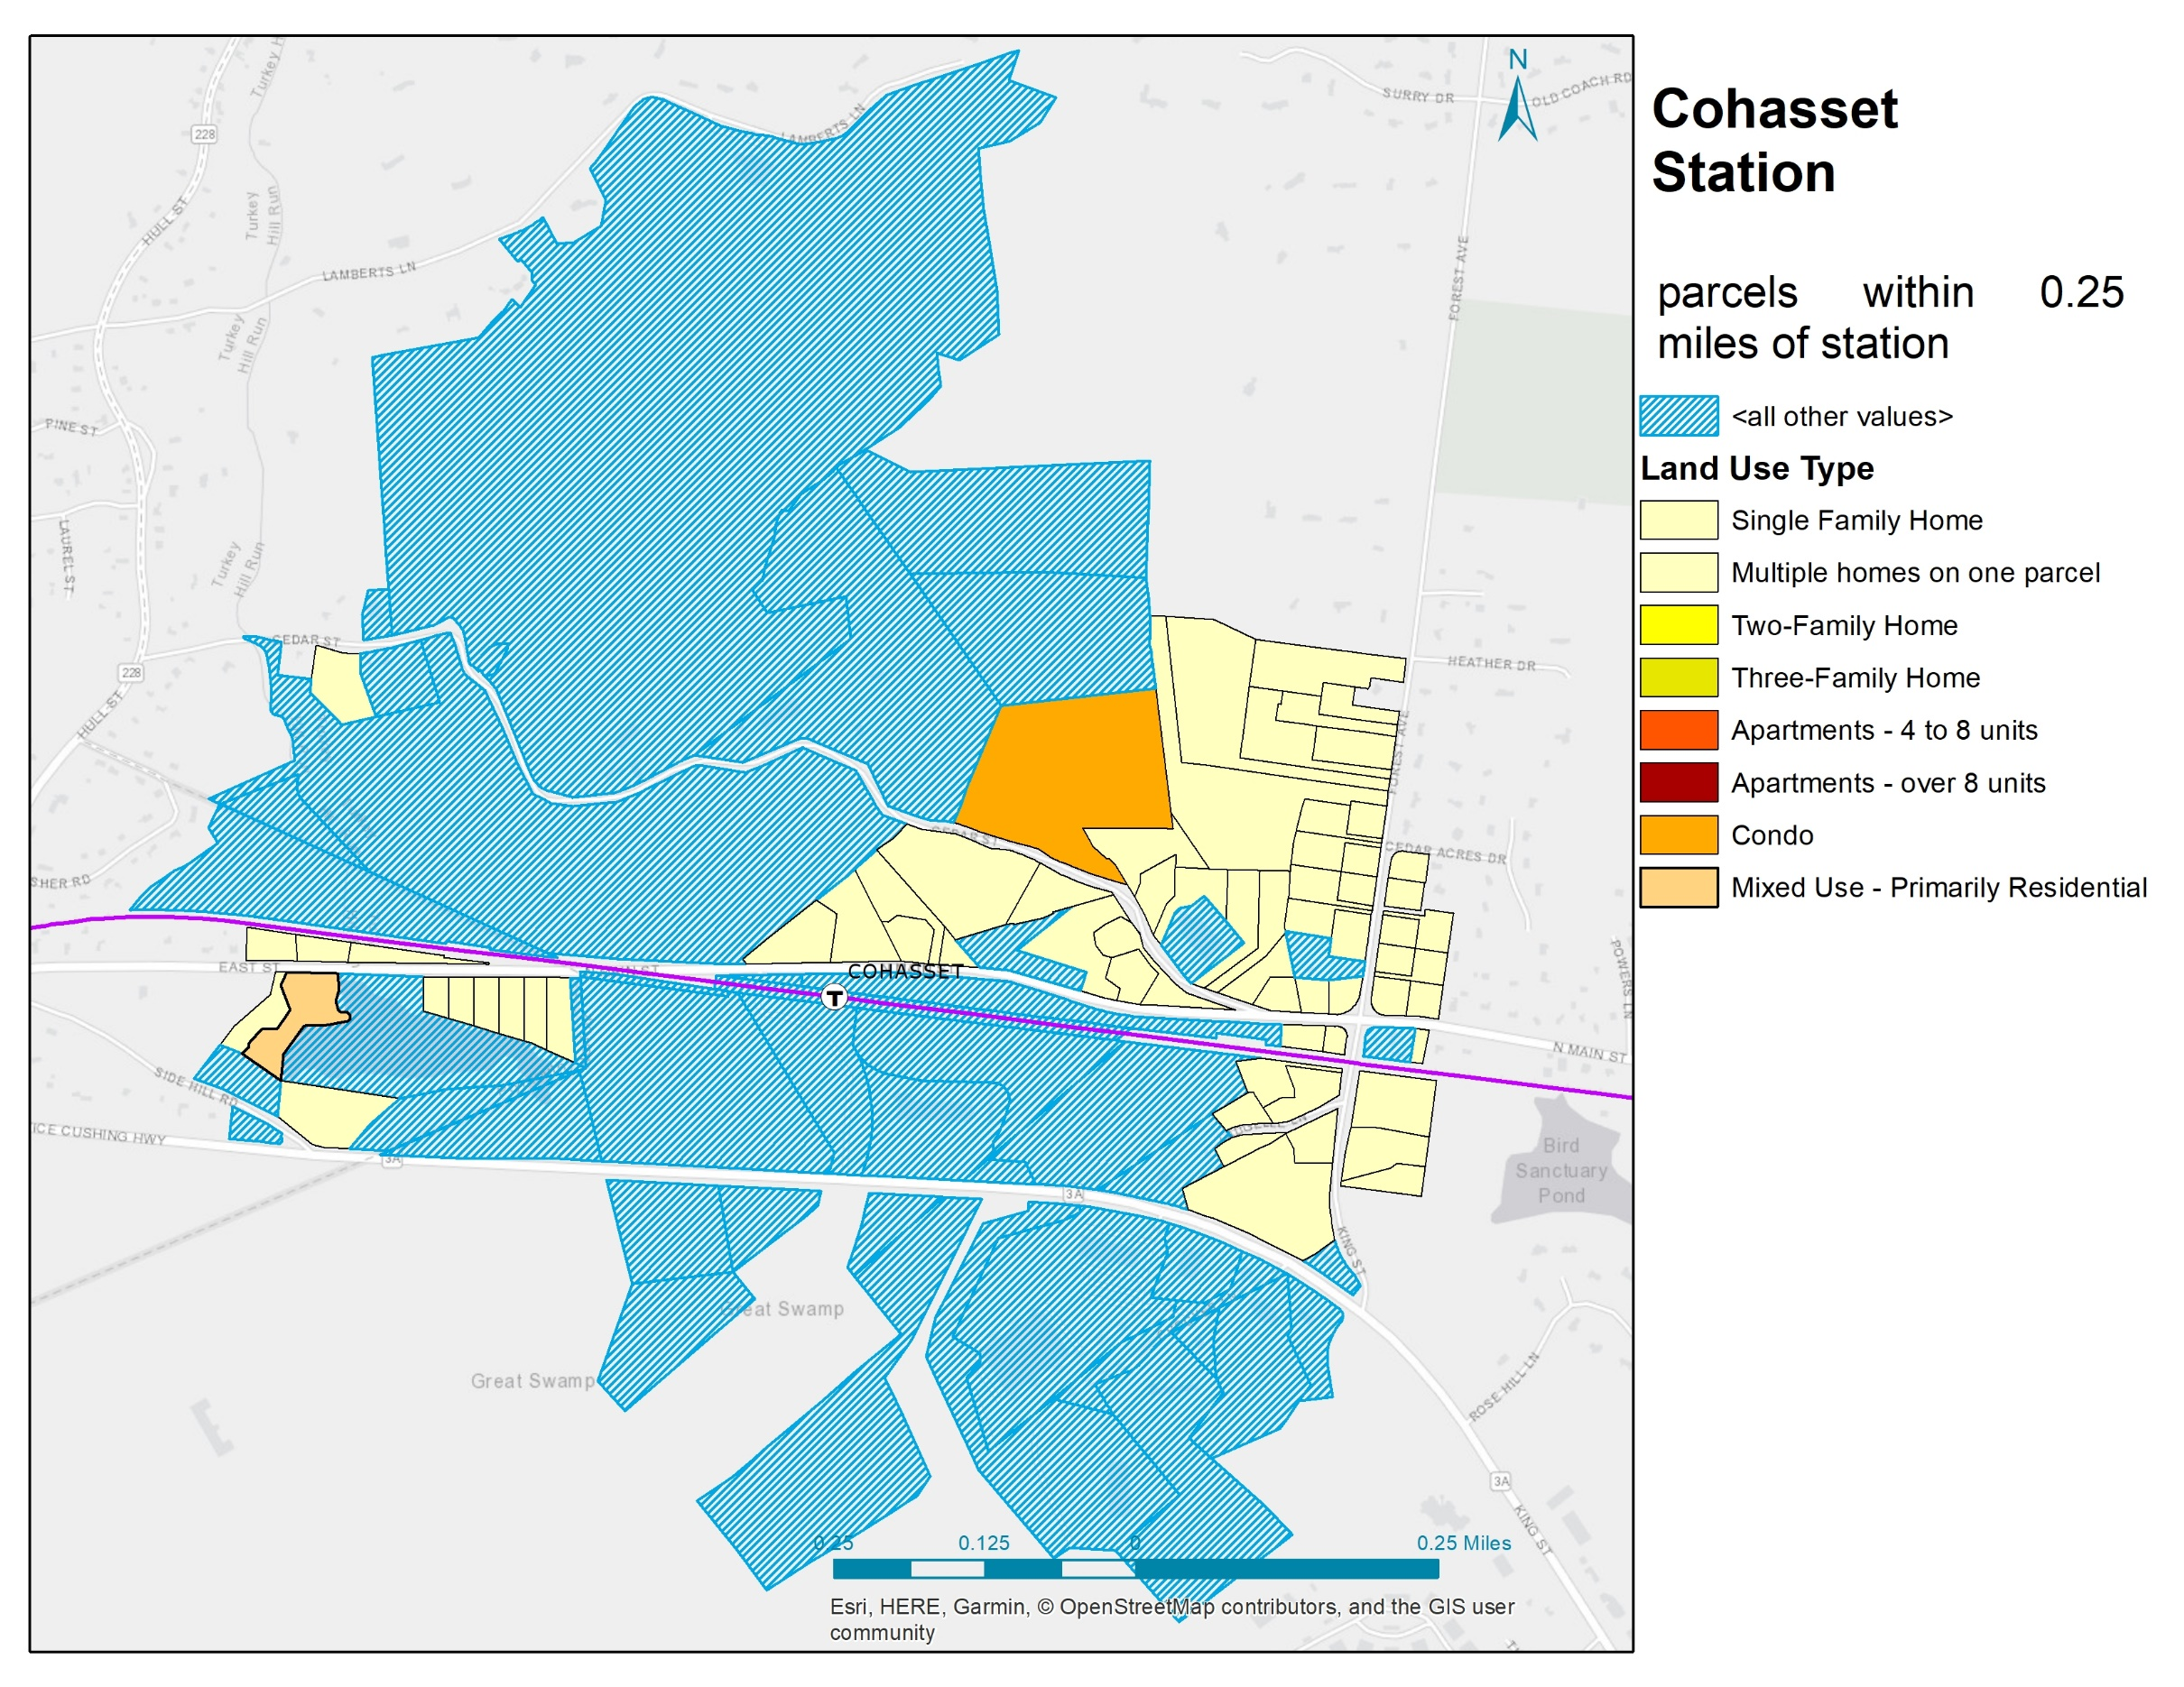
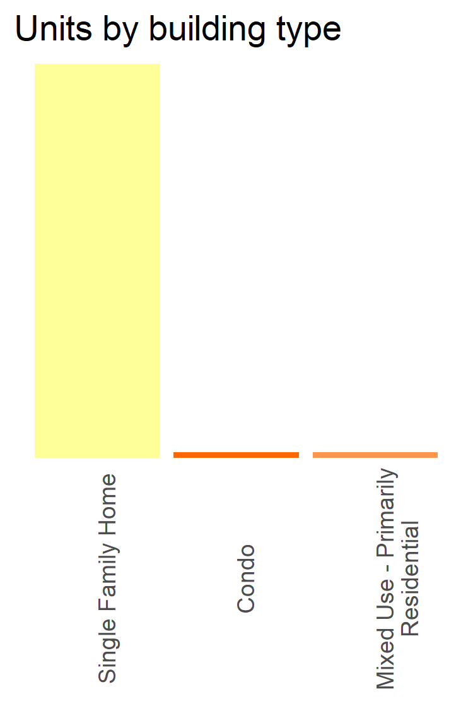
66
68
total
units
1
1

Slide 11
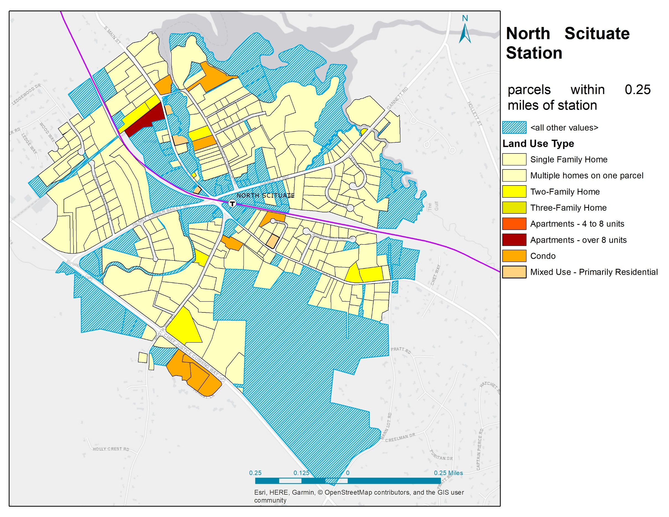
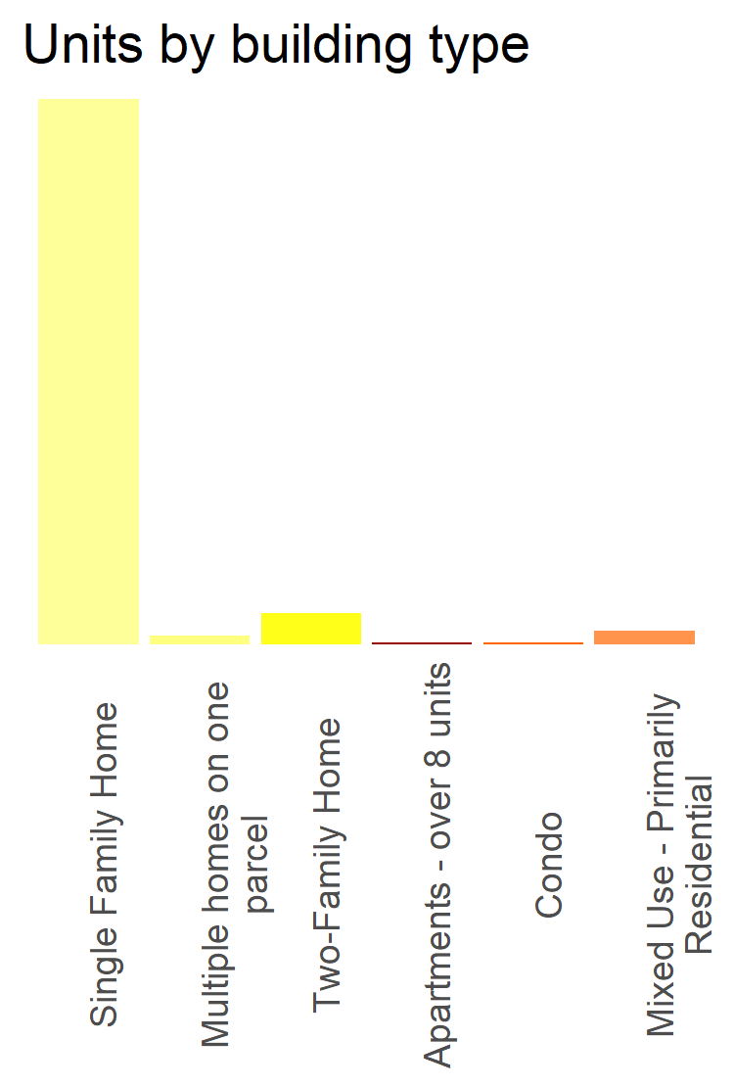
245
271
total
units
4
14
1
1
6

Slide 12
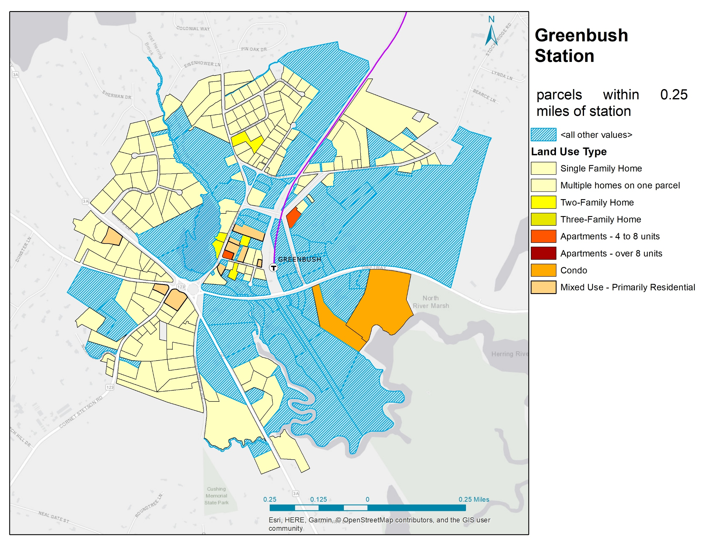
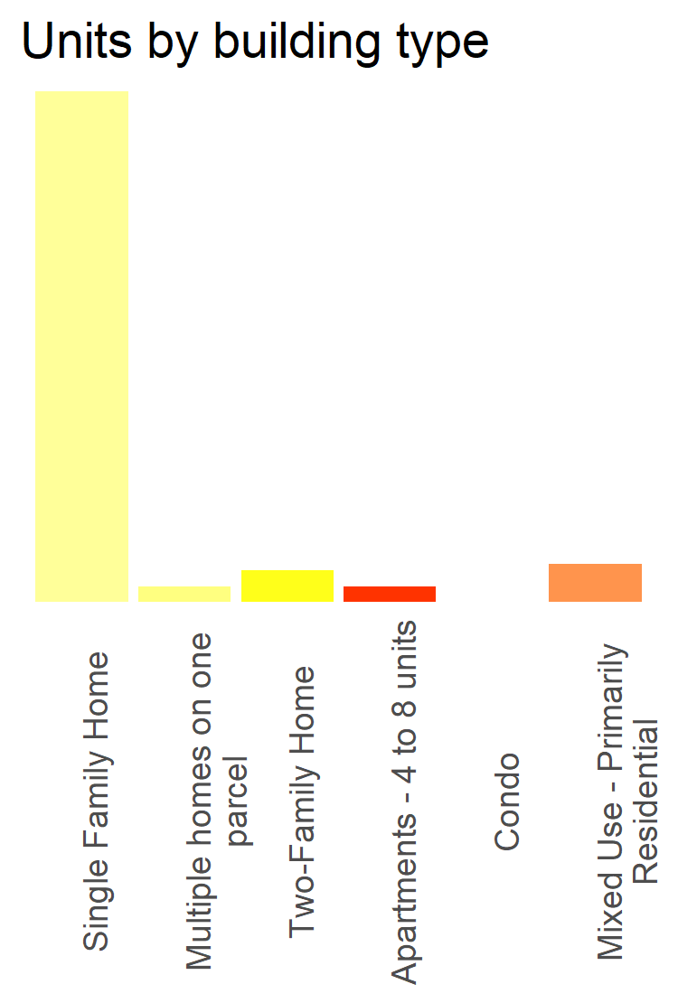
162
194
total
units
5
10
5
0
12

Slide 13
Conclusions
Variation is high when it comes to housing opportunities near commuter rail stops
Even with those data limitations, it is immediately evident that many commuter rail stops have very limited housing development within the immediate vicinity of commuter rail stations. The vast majority of housing in each of the areas I explored was single-family homes. This is consistent with my experience working in the housing sector. Communities fight against dense housing (and outsiders) for a variety of reasons, yet benefit from regional and statewide public infrastructure.
The assessor’s parcels data base used has some holes in it that limit its utility in determining what, where and when housing units have been built (missing unit, year built data points)

Slide 14
Future research
Create metrics that would allow for station to station comparisons and score each station on the success of its transit-oriented development
Pair this analysis with commuter rail ridership to see if there is a correlation between stations with more housing opportunities and higher ridership.
Use this analysis as a starting point for identifying transit-oriented parcels for future housing development or redevelopment
Explore the policy implications of maintaining statewide or regional transit infrastructure with no commitments from beneficiary towns regarding transit-oriented housing development.
Continue to explore the holes in the assessor’s parcel data set and strategize ways to enhance standardization and increase reporting quality/frequency from towns.

